Slide 1

6th Grade Accelerated Math
Unit 13, Lesson 4 Generating Equivalent Algebraic Expressions Volume 2, pg. 280

Slide 2


Benchmark
MA.6.AR.1.4
Apply the properties of operations to generate equivalent algebraic expressions with integer coefficients.
volume 2, pg. 280

Slide 3
Integrated Mathematical Thinking and Reasoning Standards
MA.K12.MTR.1.1 Actively participate in effortful learning both individually and collectively.
MA.K12.MTR.4.1 Engage in discussions that reflect on the mathematical thinking of self and others.
MA.K12.MTR.5.1 Use patterns and structure to help understand and connect mathematical concepts.
volume 2, pg. 280

Slide 4

Learning Target
I can apply properties of operations to generate equivalent expressions.
volume 2, pg. 280

Slide 5

Warm-Up
volume 2, pg. 280

Slide 6
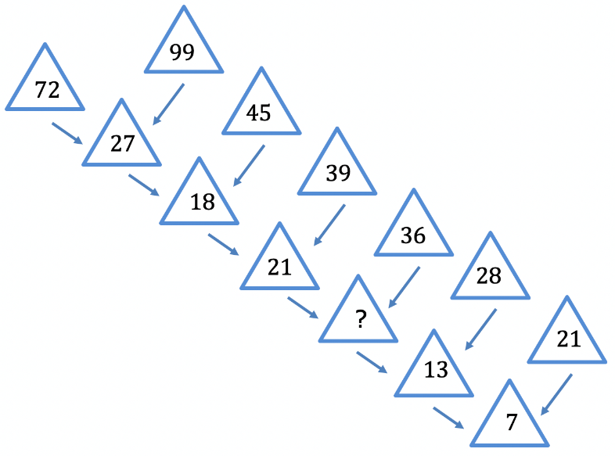
13.4.1 Warm-Up: Missing Number
What is the first number you tried for the missing number?
Did your first number work for the rest of the pattern?
What strategy did you try if your first number did not work?
volume 2, pg. 280

Slide 7

Guided Instruction
volume 2, pg. 281

Slide 8
13.4.2 Guided Instruction: Generating Equivalent Algebraic Expressions
Consider the following expressions.
$$8∙x+8∙9$$ | $$8(x+9)$$ | $$8x+9$$
Which of these expressions are equivalent?
Which property of operation justifies that the expressions are equivalent?
Write two equivalent expressions. Name the property or properties you used to create each equivalent expression.
volume 2, pg. 281

Slide 9
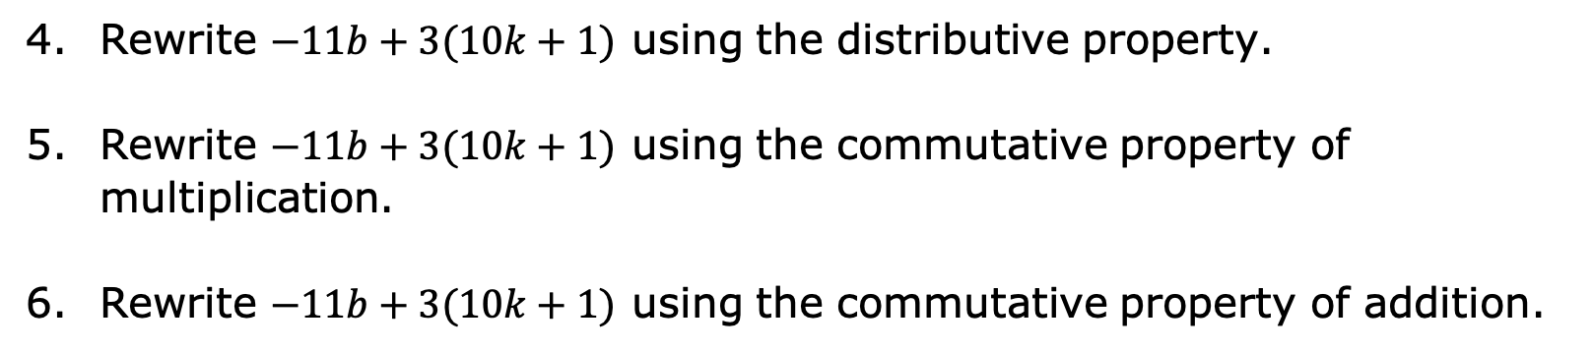
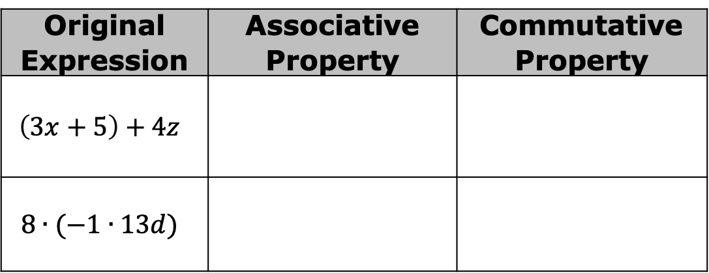
For each expression, use the associative and commutative properties to generate an equivalent expression.
Original Expression | Associative Property | Commutative Property
$$\left(3x+5\right)+4z$$
$$8∙(−1∙13d)$$
Rewrite $−11b+3(10k+1)$ using the distributive property.
Rewrite $−11b+3(10k+1)$ using the commutative property of multiplication.
Rewrite $−11b+3(10k+1)$ using the commutative property of addition.
volume 2, pg. 281

Slide 10
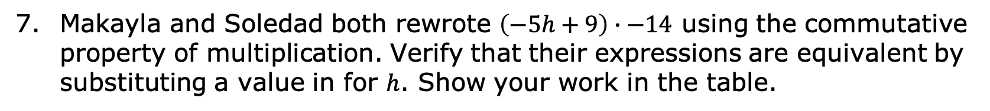
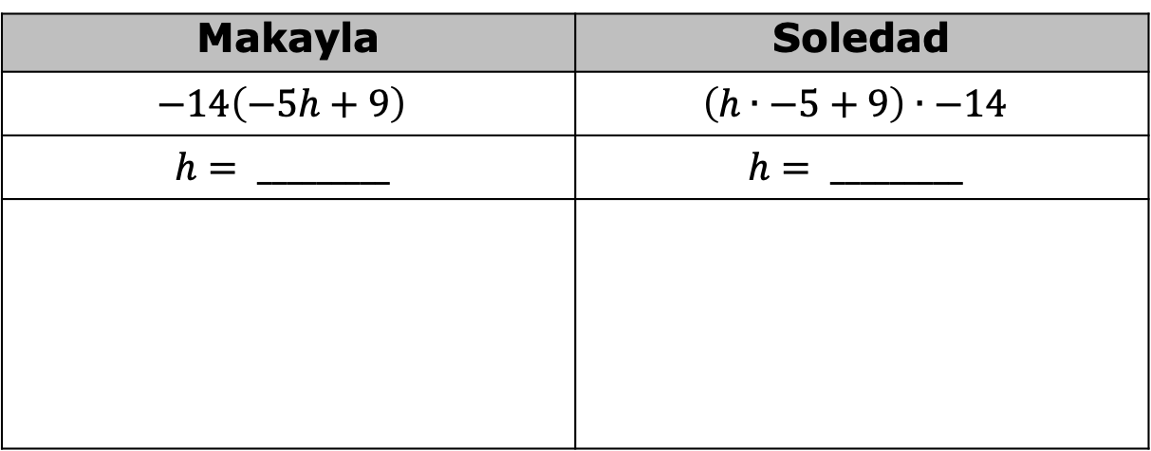
Makayla and Soledad both rewrote $\left(−5h+9\right)∙−14$ using the commutative property of multiplication. Verify that their expressions are equivalent by substituting a value in for $h$. Show your work in the table.
Makayla | Soledad
$$−14\left(−5h+9\right)$$ | $$\left(h∙−5+9\right)∙−14$$
$$h= _________$$ | $$h= _________$$
volume 2, pg. 282

Slide 11

Try It
volume 2, pg. 282

Slide 12

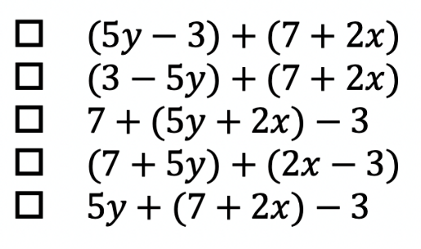
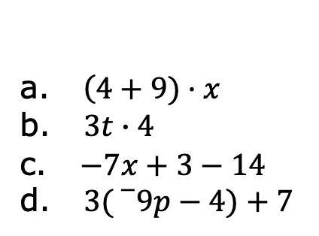

13.4.3 Try It: Writing Equivalent Algebraic Expressions
Select the expressions that are equivalent to $(2x+7)+(5y−3)$.
Write two equivalent algebraic expressions for each expression below.
a. $\left(4+9)·x\right.$
b. $3t∙4$
c. $−7x+3−14$
d. $3({}_{}^{−}9p−4)+7$
volume 2, pg. 282

Slide 13

Your Turn
volume 2, pg. 283

Slide 14
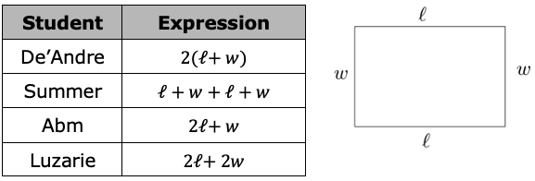
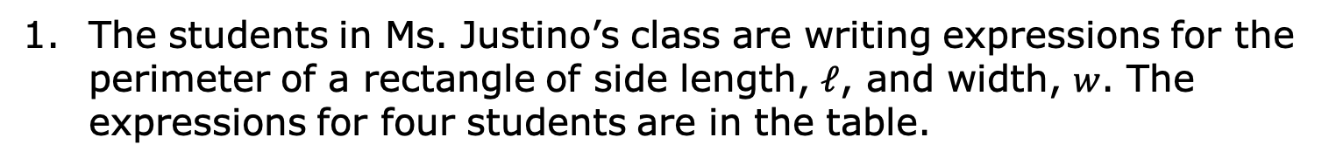
13.4.4 Your Turn!
The students in Ms. Justino’s class are writing expressions for the perimeter of a rectangle of side length, $𝓁$, and width, $w$. The expressions for four students are in the table.
volume 2, pg. 283

Slide 15
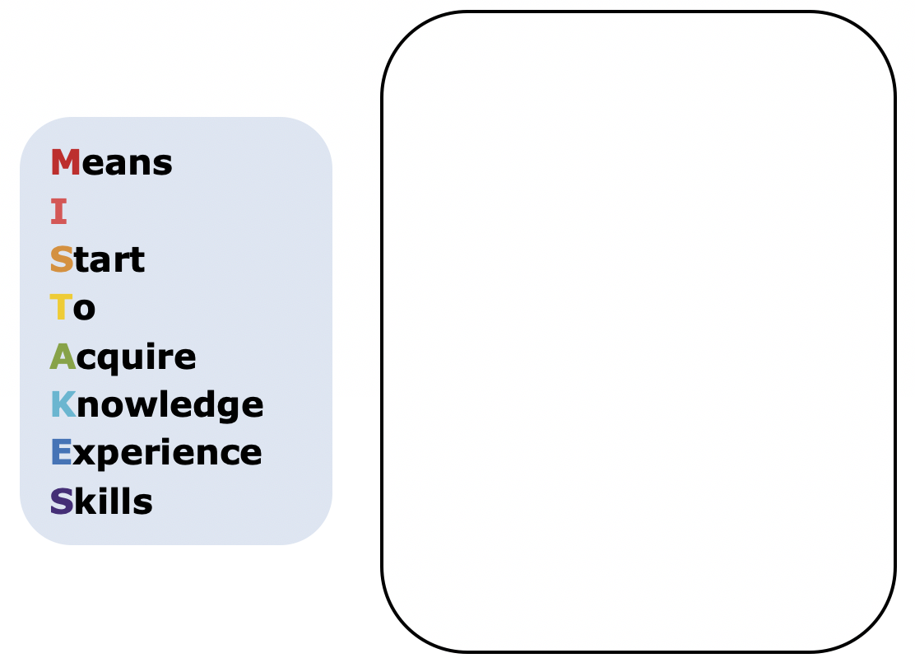
Ms. Justino told the group that one of the expressions is not equivalent. Write a short explanation to the student to show why their expression is not equivalent to the other expressions.
volume 2, pg. 283

Slide 16
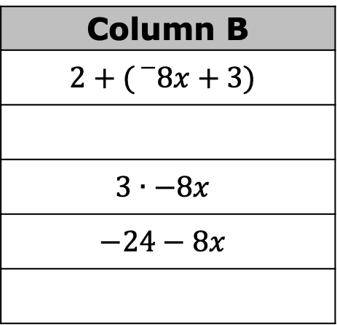
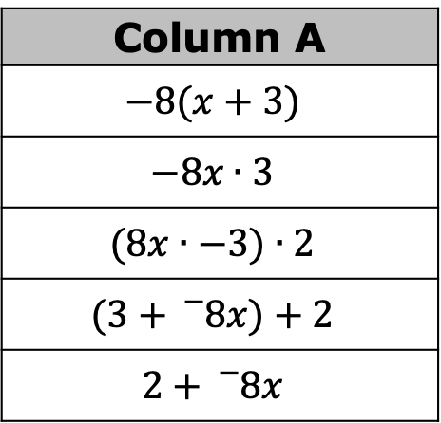
Match equivalent expressions by drawing an arrow. If an expression does not have a match, write an equivalent expression to match it in one of the blank boxes provided.
Column A
$$−8(x+3)$$
$$−8x∙3$$
$$(8x∙−3)∙2$$
$$(3+{}_{}^{−}8x)+2$$
$$2+{}_{}^{−}8x$$
Column B
$$2+({}_{}^{−}8x+3)$$
$$3∙−8x$$
$$−24−8x$$
volume 2, pg. 283

Slide 17

Wrap-Up
volume 2, pg. 284

Slide 18
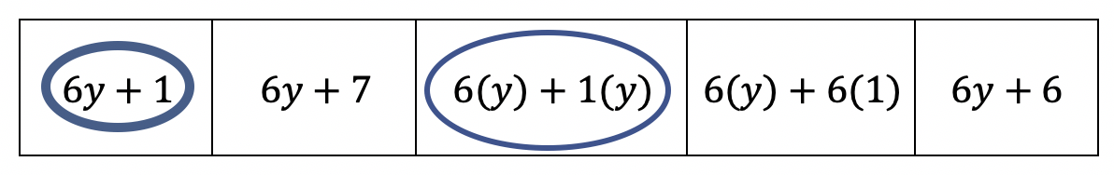
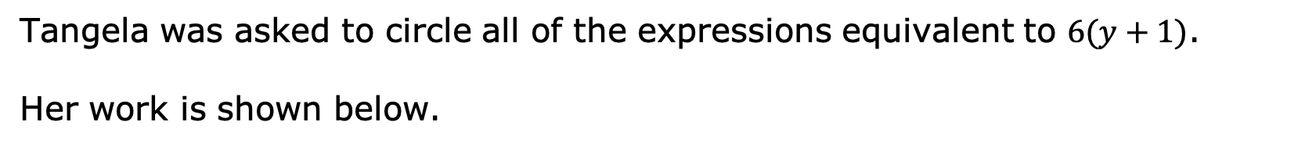
13.4.5 Wrap-Up: Error Analysis
Tangela was asked to circle all of the expressions equivalent to $6(y+1)$.
Her work is shown below.
Determine if Tangela correctly identified all of the equivalent expressions. If she is missing an expression, circle the expression(s) she is missing.
If Tangela made an error, then explain her error and list the equivalent expressions.
volume 2, pg. 284

